Slide 1
Molecules, Cells and Organs of the Immune System
‘’Cells Produce molecules to affect other cells that affect other cells’’

Slide 2
Objectives of the Presentation
To discuss;
The different specialized cells in the body
Immune molecules that execute functions of the immune system
Organs that execute functions of the immune systems
Cell homeostasis
Adaptive immune system

Slide 3
Introduction
The immune system is a host defense system comprising many biological structures and processes within an organism that protects it against disease.
Hence, to function properly, an immune system must detect a wide variety of intracellular and extracellular pathogens and distinguish them from the organism's own healthy tissue.

Slide 4
Components of the immune system
The immune system is composed of;
Specialized cells
Organs (lymphoid organs)
Immune molecules

Slide 5
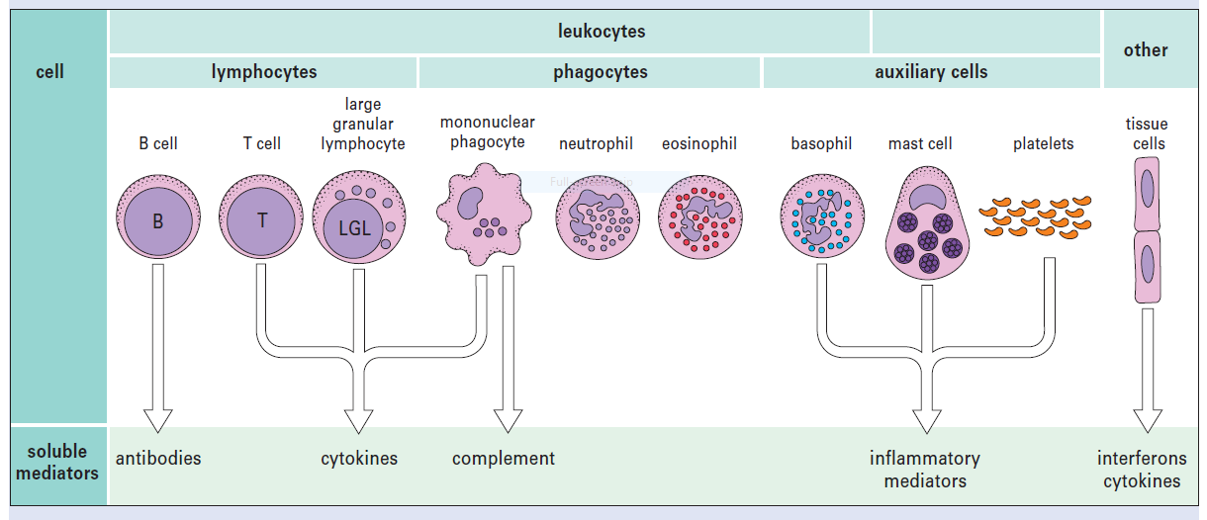
Components of the immune system…con’t

Slide 6
1. Specialized cells of the immune system
Cells of the immune system originate from the bone marrow through a process called hematopoiesis where most of them mature and later circulate in blood and in the lymphatic vessels.
Hematopoietic stem cells divide to produce two specialized stem cells i.e. a common myeloid progenitor cell that gives rise to granulocytes, monocytes, erythrocytes and megakaryocytes and a common lymphoid progenitor that gives rise to Natural killer cells, T and B lymphocytes.

Slide 7
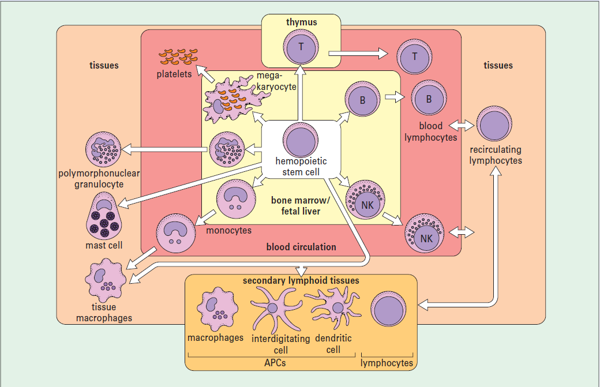
Origin of cells of the immune system - hematopoiesis

Slide 8
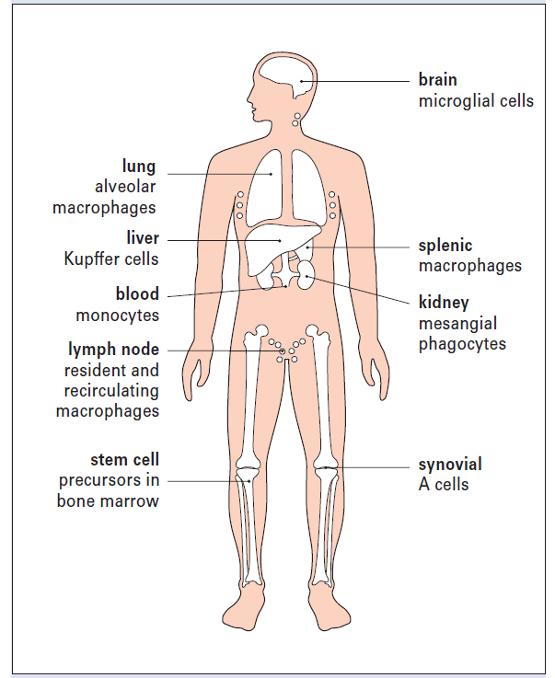
Specialized cells con’t…Phagocytes
The most important long-lived phagocytic cells belong to the mononuclear phagocyte lineage and are called monocytes.
Monocytes migrate from the blood into the tissues where they develop into tissue macrophages.
Their main function is to engulf particles including infectious agents, internalize them and destroy them. Hence they must be strategically placed where they will encounter such particles.

Slide 9
Specialized cells con’t – Polymorphonuclear Neutrophils (PMNs)
Constitute majority of blood leukocytes (40-70%)
They are short lived phagocytes - Die after engulfing material
Migrate into tissues at sites of inflammation
They have granules; primary, secondary and tertiary

Slide 10
Specialized cells con’t…Lymphocytes (T cells)
T cells have T cell antigen receptors and are of different types with a variety of functions.
Type 1 helper T cells (Th1 cells) interacts with mononuclear phagocytes and helps them destroy intracellular pathogens.
Type 2 helper T cells (Th2 cells) interacts with B cells and helps them to divide, differentiate and make antibody.
The third group of T cells are responsible for destruction of host cells that have become infected by viruses or other intracellular pathogens. This kind of action is called cytotoxicity and these T cells are therefore called cytotoxic T lymphocytes (Tc cells).

Slide 11
Specialized cells con’t…Functions of T cells
Recognize antigens ONLY when presented on the surface of other cells by MHC
T cell Antigen Receptors are related in structure and function to surface antibody which cells use as antigen receptors
Release soluble proteins and cytokines that signal to other cells
Also function via cell to cell interactions directly

Slide 12
Specialized cells con’t…Lymphocytes (B cells)
B and T cells bear receptors that recognize specific molecular components of pathogens and hence initiate adaptive immune responses.
B cells express antibody because they are genetically programmed to express a surface receptor specific for a particular antigen. If a B cell binds to its specific antigen, it will multiply and differentiate into plasma cells which are specific to only that antigen.

Slide 13
Specialized cells con’t…Cytotoxic cells
Cytotoxic cells recognize and destroy other cells that have become infected and they include Natural Killer (NK) cells and Eosinophils.
NK cells have the capacity to recognize the surface changes that occur on a variety of tumor cells & virally infected cells and later damage these target cells.
Eosinophils are a specialized group of leukocytes that have the ability to engage and damage large extracellular parasites, such as schistosomes.

Slide 14
Specialized cells con’t…Cells of Inflammation
The main purpose of inflammation is to attract leukocytes and soluble mediators of immunity towards a site of infection. Inflammation is mediated by a variety of cells including basophils, mast cells, and platelets.
Basophils and mast cells have granules that contain a variety of mediators which induce inflammation.
Platelets are essential in blood clotting, but can also be activated during immune responses to release mediators of inflammation.

Slide 15
2. Immune molecules
A wide variety of molecules are involved in the development of immune responses including antibodies, cytokines and other molecules that are normally present in serum.
The serum concentration of a number of these proteins increases rapidly during infection and they are therefore called acute phase proteins.

Slide 16
Immune molecules con’t
One example of an acute phase protein is C reactive protein (CRP); so-called because of its ability to bind to the C protein of pneumococci which promotes it’s uptake by phagocytes in a process known as Opsonization.
Molecules such as antibody and CRP that promote phagocytosis are said to act as Opsonins. Another important group of molecules that can act as opsonins are components of the complement system.

Slide 17
Immune molecules con’t…Acute phase proteins
Acute Phase Protein | Function in the Immune system
C-reactive protein | Opsonin on microbes
Serum amyloid P component | Opsonin
Serum amyloid A | Recruitment of immune cells to inflammatory sites Induction of enzymes that degrade extracellular matrix
Complement factors | Opsonization, lysis and clumping of target cells and Chemotaxis
Mannan-binding lectin | Mannan-binding lectin pathway of complement activation
Fibrinogen, prothrombin, factor VIII, von Willebrand factor | Coagulation factors, trapping invading microbes in blood clots and some cause chemotaxis

Slide 18
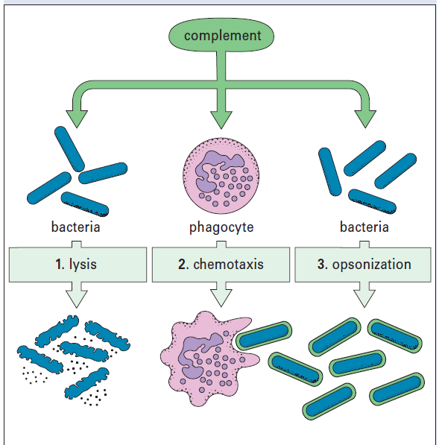
Immune molecules con’t…Complement
Damage to plasma membranes on cells (lysis)
Attraction of phagocytes to sites of infection (Chemotaxis)
Opsonization of microorganisms for uptake by phagocytes
Increased blood flow to the site of activation and in se permeability of capillaries to plasma molecules
Release of inflammatory mediators from mast cells.

Slide 19
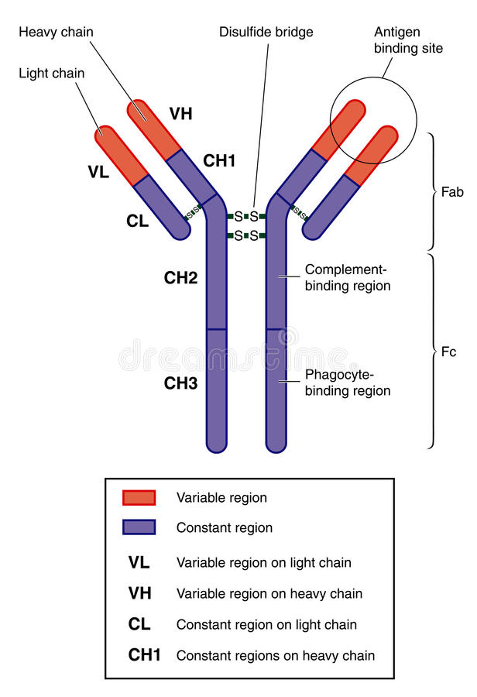
Immune molecules con’t…Antibodies
Antibodies are soluble glycoproteins that recognize and bind antigens present in serum, tissue fluids or on cell membranes.
Immunoglobulins also function as membrane-bound antigen receptors on B cells and play key roles in B cell differentiation.
There are five classes of antibody in mammals – IgG, IgA, IgM, IgD, and IgE.

Slide 20
Immune molecules con’t…Antibodies
Class | Description
IgA | Found in mucosal areas, such as the gut, respiratory tract and urogenital tract. They prevents colonization by pathogens. Also found in saliva, tears and in breast milk.
IgD | Functions mainly as an antigen receptor on B cells that have not been exposed to antigens. It also activates basophils and mast cells to produce antimicrobial factors.
IgE | Binds to allergens and triggers histamine release from mast cells and basophils and is also involved in allergy. IgE also protects the body against parasitic worms
IgG | In its four forms, provides the majority of antibody-based immunity against invading pathogens. The only antibody capable of crossing the placenta to give passive immunity to the fetus.
IgM | Expressed on the surface of B cells and in a secreted form with very high avidity. Eliminates pathogens in the early stages of B cell-mediated (humoral) immunity before there is sufficient IgG.

Slide 21
Immune molecules con’t…Cytokines
Cytokines are a group of proteins secreted by cells of the immune system that act as chemical messengers.
Their main role is to help regulate the immune response and are of five different types which include Chemokines, Interferones, Interleukines, Lymphokines and Tumor Necrosis Factor.

Slide 22
Immune molecules con’t…Chemokines
Chemokines induce chemotaxis by calling in cells to the sites of infection.
Chemokines have been classified into four main subfamilies i.e. CXC, CC, CX3C and XC.
All of these proteins exert their biological effects by interacting with chemokine receptors that are selectively found on the surfaces of their target cells.
Cells that are attracted by chemokines follow a signal of increasing chemokine concentration towards the source of the chemokine.

Slide 23
Immune molecules con’t…Interferons
Interferons (IFN) are proteins that inhibit viruses from replicating.
If a cell gets infected by a virus, it releases IFNα and IFNβ in addition to IFNγ released by activated Th1 cells.
This signals other cells to put up their shields so that the virus doesn’t spread (macrophages form granulomas).
Interferons also activate NK cells to fight against viral infected cells.

Slide 24
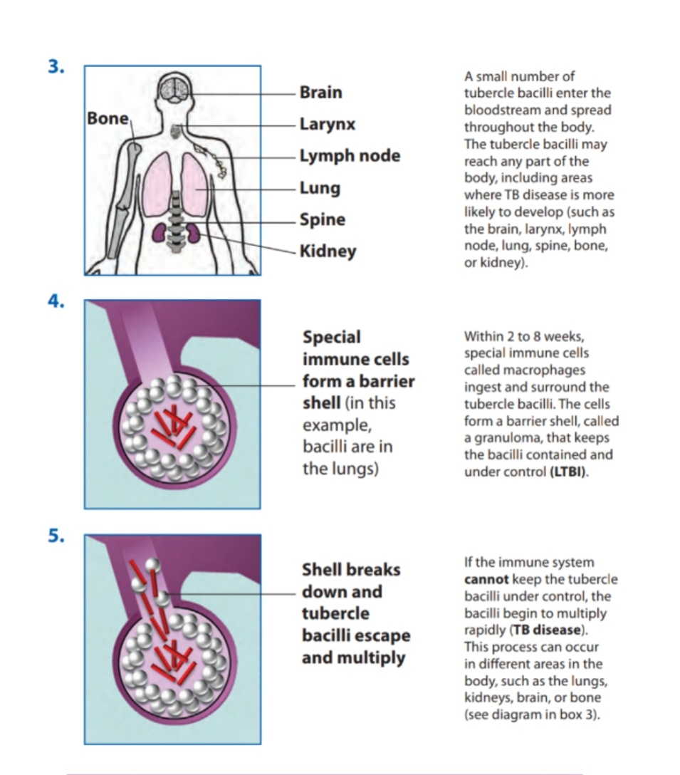
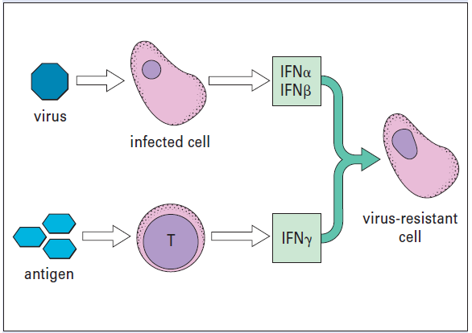
Immune molecules con’t…Interferones
Granuloma - TB Disease
Action of Interferones

Slide 25
Immune molecules con’t…Interleukins
Interleukins (IL) are proteins that regulate immune and inflammatory responses.
They are produced by WBCs and their role in the immune system is to promote growth, maturation and activation of immune cells.
Several types are there though we will discuss only a few of them.

Slide 26
Interleukins (IL) | Source | Target cell | Function in the target cell
IL 1 | Macrophages | Endothelium | Induce fever & inflammation
 |  | B cells | Maturation & proliferation
 |  | NK cells | Activation
IL 2 | Th1 cell | T cells | Stimulates growth & differentiation of T cell
IL 3 | Activated Th cells, NK cells | Hematopoietic cells | Differentiation and proliferation of myeloid progenitor cells
IL 5 | Th cells & Esinophils | Esinophils | Activation & production
 |  | B cells | Differentiation & IgA production
IL 6 | Macrophages, B cells & Th cells | Activated B cell | Differentiation into plasma cells
 |  | Plasma cells | Antibody secretion
 |  | Hematopoietic cells | Differentiation
IL 8 | Lymphocytes | Neutrophil | Neutrophil chemotaxis
IL 14 | T cells | Activated B cells | Controls growth & proliferation of B cells
IL 15 | Mononuclear phagocytes | Activated B cells and T cells | Induces production of NK cells

Slide 27
Immune molecules con’t…Tumor Necrotic Factor
Tumor Necrotic Factor (TNF) is the main trigger of inflammation.
It affects local blood vessels by increasing vascular permeability which leads to accumulation of immunoglobulins, complements and blood proteins in the tissue.

Slide 28
3. Organs of the immune system
Primary lymphoid organs are sites where stem cells divide and become immunocompetent - capable of recognizing and attacking foreign antigens to elicit an immune response.
B cells stay in the bone marrow until they are immunocompetent before moving to secondary lymphoid organs while T cells move to the thymus for maturation before moving to secondary lymphoid organs

Slide 29
Organs of the immune system con’t…
Secondary lymphoid organs are sites of lymphocytes recirculation between blood and these organs and also sites of lymphocyte activation by antigen. Examples include the lymph nodes, the spleen, adenoids, tonsils, appendix and peyer’s patches.
Lymph nodes filter and cleanses the lymph as it passes through a node. In the process, they filter damaged cells, cancerous cells, cellular debris, bacteria and viruses which become trapped in the reticular tissue of the lymph node and are destroyed by the action of lymphocytes and macrophages.

Slide 30
Organs of the immune system con’t…
The spleen is the largest lymphoid organ. It filters blood after which trapped pathogens and cell debris are destroyed by lymphocytes and macrophages. It also acts as a major site of lymphocyte activation and proliferation.
The gut-associated lymphoid tissues (GALT) include the tonsils, adenoids, appendix and specialized structures called Peyer's patches in the small intestine.

Slide 31
Organs of the immune system con’t…
The GALT collect antigen from the epithelial surfaces of the gastrointestinal tract which are destroyed by lymphocytes and macrophages.
Similarly, there is also bronchial-associated lymphoid tissue (BALT) and mucosal associated lymphoid tissue (MALT) which protect the respiratory track and mucosal track respectively.

Slide 32
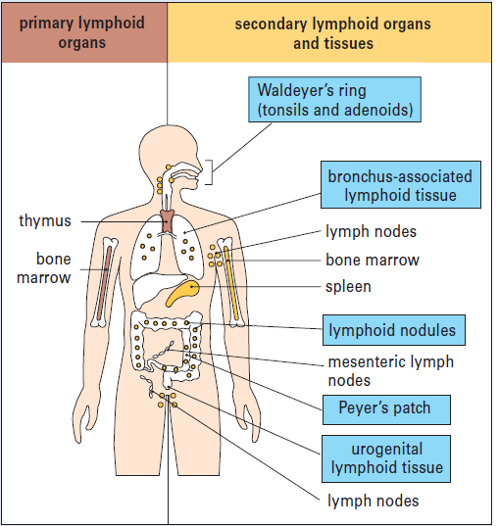
Major lymphoid organs and tissues

Slide 33
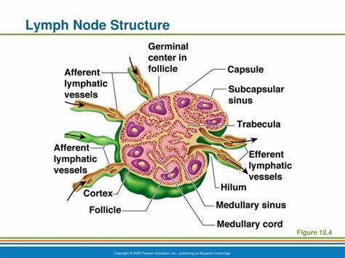
Structure of a Lymph Node

Slide 34
Cell homeostasis
Homeostasis is a controlled process that generally maintains a constant steady state in production of mature blood cells.
Homeostasis is regulated by a complete mechanism that involves;
Use of cytokines (interleukins) to either suppress or promote differentiation and proliferation of cells (See Table 3, for functions of ILs)
A programmed cell death of old cells – Apoptosis

Slide 35
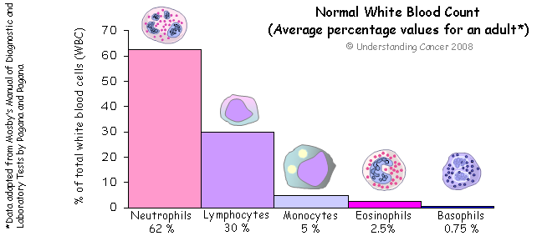
Cell homeostasis con’t…

Slide 36
Cell homeostasis con’t…
Low blood cells mainly occurs during an infection, anemia, Thalassemia etc.
Failure to control blood cell levels to the norm, this results into auto-immune disorders such as leukemia, Polycythemia vera, sickle cell, lymphoma, Myelodysplastic syndrome, hemophilia etc.

Slide 37
Cell Receptors…Lymphocytes
There are two major types of Lymphocytes:
B lymphocytes and
T lymphocytes
Lymphocytes have cell surface Receptors which endow them with Fine-Specificity Recognition
Antibodies are the antigen-specific receptors on B lymphocytes

Slide 38
Cell Receptors…T-Cell Receptors (TCRs)
T cells receptors bind an MHC peptide Complex T cells also have coreceptors which
bind MHC Like MHC molecules which come in two “flavors”, these coreceptors also have two flavors: CD4 and CD8
Unlike B cell receptors (Antibody) T cell receptors DO NOT have a secreted form

Slide 39
Adaptive immune receptors are very specific and diverse
• There are only a limited number of receptors recognizing PAMP’s. For instance, 13 TLR’s have been identified.
The number of MHC molecules is greater, but still limited (100’s of possible MHC’s only a few of which are expressed by any single individual-diversity is at a population level)
• Lymphocyte receptors (adaptive immunity) are extremely diverse 10e8 to 10e10 possibilities for any individual. They can recognize fine structural details.
• The repertoire of lymphocyte receptors is also very flexible--receptors can be produced versus chemical compounds which have not yet been synthesized.

Slide 40
ADAPTIVE (acquired) IMMUNITY
Diversity!
Qu!estion: Can each individual lymphocyte express the entire repertoire of diverse receptors or does each individual lymphocyte express only a single receptor with a single specificity?

Slide 41
Development of the Mature B lymphocytes
Given four naïve B lymphocytes and the capability to recognize four different chemical structures is each lymphocyte capable of recognizing all four chemical structures or is each lymphocyte capable of recognizing only one of the four chemical structures?!

Slide 42
B cell development at specificity
The specificity of lymphocytes is conveyed by specific receptors on their surface which can interact with antigens.
Each lymphocyte has receptors of only a single specificity on its surface.
Thus each lymphocyte can recognize only a single antigen.
Diversity is conveyed by a large number (10e8 or more) of different lymphocytes, each with a different receptor and thus a different specificity.

Slide 43
Clonal selection-selecting sensitized cells

Slide 44
Activation-Adaptive Immunity
Activation of Adaptive Responses takes a longer time in part because a very low frequency of highly specific lymphocytes must be expanded and differentiated after recognition of an “antigen” (Clonal Selection)

Slide 45
Activation of adaptive immunity
Activation of Adaptive Responses takes a longer time in part because of Clonal Selection
Activation of Adaptive Responses also requires the participation of several cell types which must be brought together in lymph nodes, spleen, or mucosal sites such as Peyer’s patches:
Antigen presenting cells such as dendritic cells process and present antigen to T cells
B lymphocytes require “help” from T lymphocytes to produce optimal levels and classes of antibody
Helper T cells can also amplify (and are often required for) the response of other T cells

Slide 47
Activation of adaptive immune system….. Role of cytokines
IL-12 stimulates differentiation of naïve CD4+ T-cells to Th1 subset of effector cells,
IL-1,IL-6, and IL-23 stimulate differentiation of naïve CD4+ T cells to Th17 subset of effector cells,
IL-25, IL-33, stimulate differentiation of naïve CD4+ T cells to the Th2 subset of effector cells,
IL-15 promotes survival of memory CD8+ T cells,
IL-6 promotes the production of antibodies by activated B cells

Slide 48
Activation of Adaptive immunity…Examples

Slide 49
First antigen and second antigen and Immune response

Slide 50
Serum antibody Vs Immunologic memory

